Slide 1

Lab Inventory Management API
Case Study : Intelligent Systems in Production
Allan Johns
Amritesh Vadakkedath Babu
Anaz Nizarudeen Raseena Beevi
Asin Sona Thomas

Slide 2
Introduction
Goal : create an Inventory Management System (IMS) API for managing lab equipment and materials.
This API will automate tasks such as adding, updating, deleting, and retrieving inventory items, which is currently done manually.

Slide 3
Introduction – What is an API ?
An API (Application Programming Interface) allows different systems to communicate with each other.
We’re using an API because it enables efficient and structured communication between the front-end (or other systems) and the inventory database, making inventory management more dynamic and automated.

Slide 4
Introduction – Benefits of an API
Automation: Eliminates manual errors and speeds up the inventory management process.
Real-time Updates: Provides lab staff with up-to-date information on available items.
Scalability: The API can easily be extended to support more features in the future.

Slide 5
Problem Statement
Current Challenges with Lab Inventory:
Manual Process: Inventory tracking is done manually using spreadsheets or paper, prone to errors and delays.
Inaccuracies: Inventory data may not always be up-to-date, leading to issues like over-ordering or equipment shortages.
Time-Consuming: Lab staff must manually check inventory levels, reducing efficiency

Slide 6
Project Overview
Inventory Management: The API provides functionality to manage the inventory by allowing CRUD operations (Create, Read, Update, Delete).
Security: Basic token-based authentication to ensure that only authorized users can modify the inventory.
HTML Response: The API returns data in HTML format, which is ideal for rendering in web browsers.

Slide 7
Technology Stack
Flask (Backend Framework):
Why Flask?: Flask is a lightweight Python web framework, perfect for building RESTful APIs. It’s easy to use, flexible, and ideal for small to medium-sized projects like this.
Flask will handle the routing and logic for the API endpoints, allowing us to define actions like creating or retrieving inventory items.

Slide 8
Technology Stack
SQLite (Database):
Why SQLite?: SQLite is a lightweight, file-based database that doesn't require a separate server. It’s simple, making it suitable for this project where we need to store and retrieve inventory data.
SQLite will be used to store inventory items, their quantities, locations, and statuses.

Slide 9
Technology Stack
HTML (Response Format):
Why HTML?: Instead of using JSON (the usual choice for APIs), we are using HTML for this project because the API is intended to render inventory data directly in web browsers. HTML makes it easier to present data in tables or lists for web-based users.

Slide 10
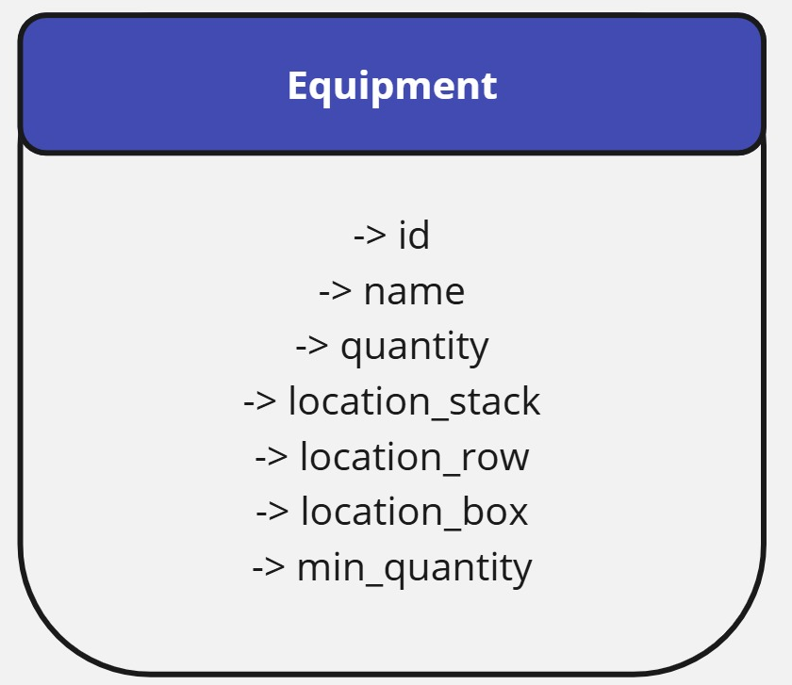
Database Schema

Slide 11
API End Points
GET /items – Fetches a list of all inventory items.
POST /items – Adds a new item to the inventory.
PUT /items/<id> – Updates the details of an item.
DELETE /items/<id> – Deletes an item from the inventory.

Slide 12
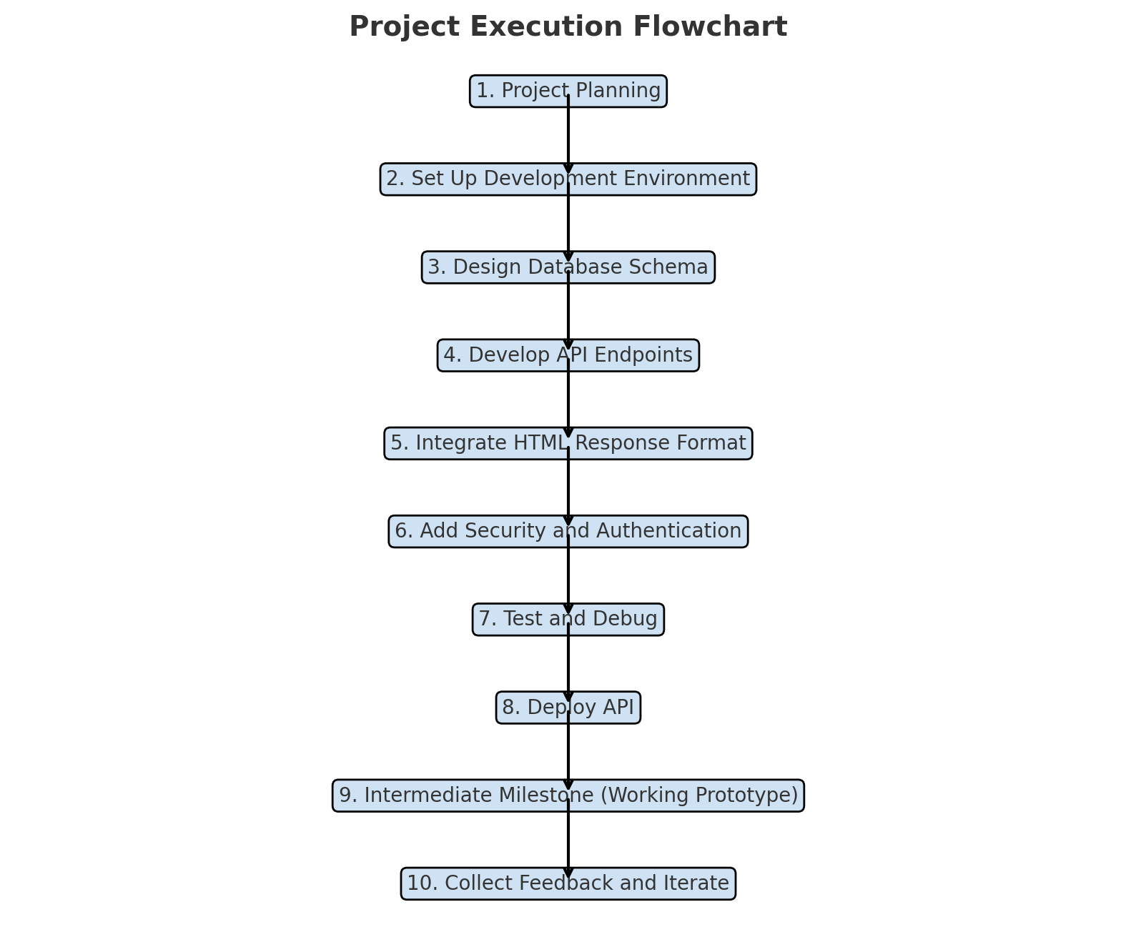

Slide 13
Objectives for Phase II
Create an Sql-lite database with necessary data fields
Collect initial data manually
Define API end-points

Slide 14
Questions ?

